Slide 1







Welcome To
ANNEX
PAY
Project by TEAM HASH INCLUDE

Slide 2

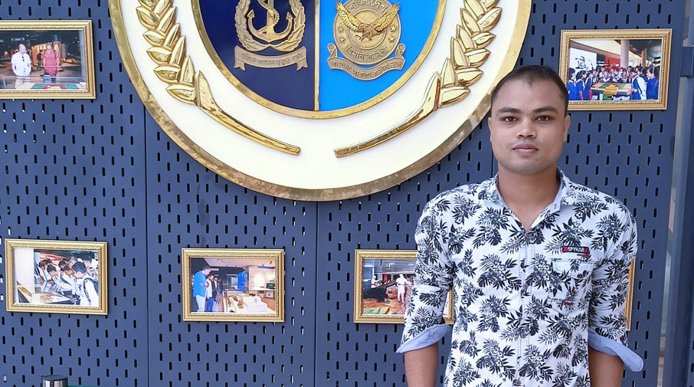


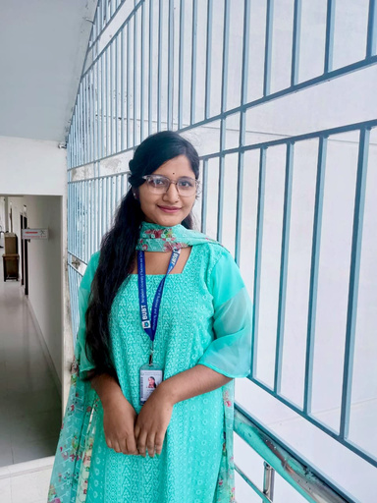




MEET OUR TEAM
Md. Monirul Hasan
Ahana Islam
Hafsa Akter
ID: 20255103087
ID: 20255103118
ID: 20255103119
Bithi Rani Debi
Arpita Deb Aishee
ID: 20255103086
ID: 20255103083

Slide 3


"OBJECTIVES"
What ANNEX PAY Aims to Achieve :
Build a secure and efficient banking system
Replace slow manual banking tasks with automation
Store and manage user data safely using file handling
Provide smooth user and admin workflows
Add real-life features to make banking systems easier
Create a colorful, interactive experience

Slide 4

“PROBLEM STATEMENT”
What Problem We Tackled :
Real banking operations involve dozens of steps, but academic projects only cover 10% of them.
Students don’t have an easy-to-use tool to visualize how banking logic actually works.
Manual handling of money in small campus activities often leads to confusion, miscommunication, and missing records.
There was a need for a secure, modular, and learning-focused banking simulator that behaves like a real system.

Slide 5



OUR SOLUTION – ANNEX PAY
Your Complete Banking Ecosystem
Console-based interface with colorful visuals & smooth navigation
19+ banking operations: deposits, transfers, bill payments, loans & more
Secure login & authentication with PIN & recovery options
Two modules: Admin and User, each with full control
Cross-platform compatible: Works on Windows & Linux
Data persistence: All transactions & accounts saved safely

Slide 6



KEY FEATURES:
– Account Creation & Management
– Deposits, Withdrawals, Transfers
– Bill Payments & Mobile Recharge
– Loan Processing System

Slide 7





ADVANCED FEATURES:
Fund Request
Account Recovery
Apply for Checkbook
User can request Fund between users.
User can set a Security Questions for PIN Recovery
User Can Sent Checkbook Requests to Admin

Slide 8




ADVANCED FEATURES:
Messaging System
Referral Program
Transaction Search & History
If user face any problems, they can sent direct message to the admin.
If a User refer to another, they both will get bonuses.
User can search Transaction History by date and amount

Slide 9
PROGRAM SENARIO:
Messaging System
Referral Program
Transaction Search & History
If user face any problems, they can sent direct message to the admin.
If a User refer to another, they both will get bonuses.
User can search Transaction History by date and amount

Slide 10

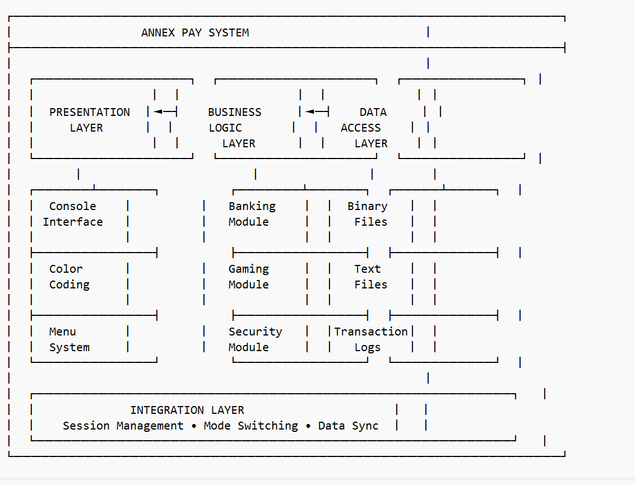
TECHNICAL ARCHITECTURE :
File-based data storage (binary + text)
Modular programming approach
Platform-independent code
Secure input handling with PIN masking
Error handling & validation

Slide 11


SECURITY FEATURES
Multi-layer Protection:
4-digit PIN authentication
Account locking after 3 failed
attempts
Security question-based recovery
Daily withdrawal limits (20,000 BDT)

Slide 12




WHAT MAKES ANNEX PAY SPECIAL:
Referral System - Earn bonuses by inviting friends
User Experience - Colorful interface with loading animations
Comprehensive Features - Beyond basic deposit/withdraw
Admin Control - Complete system management

Slide 13

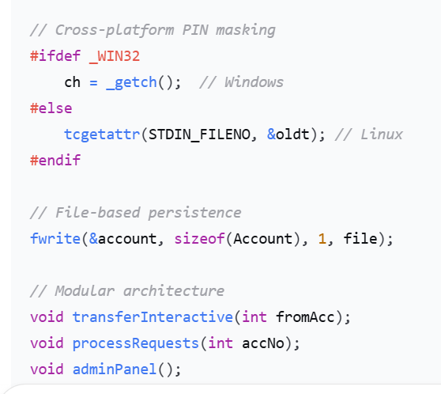

CODE HIGHLIGHTS
Technical Excellence:
// File-based persistence
fwrite(&account, sizeof(Account), 1, file);
// Modular architecture
void transferInteractive(int fromAcc);
void processRequests(int accNo);
void adminPanel();

Slide 14



CHALLENGES & SOLUTIONS
Technical Challenges
Data Persistence → Binary file handling
Security → PIN masking & account locking
Cross-platform → Conditional compilation
UI/UX → ANSI colors & loading animations

Slide 15

FUTURE ENHANCEMENTS
What's Next for ANNEX PAY:
GRAPHICAL USER INTERFACE (GUI)
Network connectivity for multi-user
Database integration
Mobile application
Enhanced security with encryption
Interest calculation & advanced reporting

Slide 16


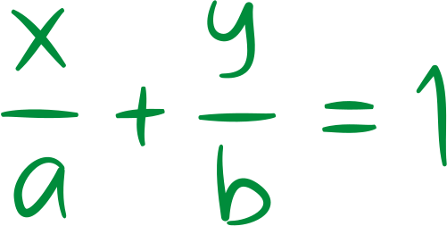

CONCLUSIONS
ANNEX PAY - More Than Just Code
A complete banking solution
Foundation for real financial systems
Demonstration of software engineering principles

Slide 17

THANK YOU!
ANY QUESTIONS?
contact : Team Hash Include

